Slide 1
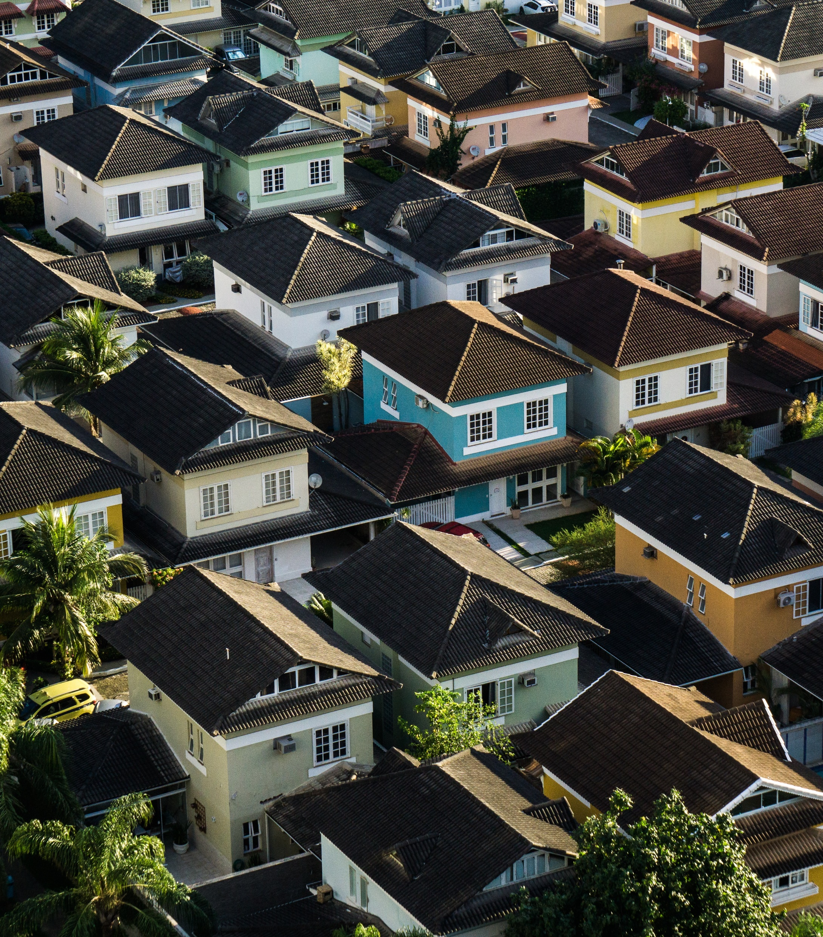
U.S. Real Estate Investment Opportunities
ZED² Solutions
Spring 2018

Slide 2

Agenda
Assumptions / Headlines
Methods
Findings
Recommendations / Future Work

Slide 3
Assumptions
Properties are purchased outright
Annual return is 10% of the property value
Monthly rent is set at 1%, raised annually
Annual maintenance costs average 1%
Other costs of additional 1% per year
Properties will be rented for a period of 5 years
Notes:
ROI is calculated assuming the property is purchased outright with no financing
Assume monthly rent will be set at the standard 1% of the property value and will increase in lock step with the assessed home value, home maintenance will cost 1%, insurance and taxes will cost an additional 1%, bringing the total annual ROI to 10%
Properties are rented without interruption for a period of 5 years. We’ve calculated what we expect the home value to be in the zipcode at that time and assessed your return on the initial investment for you as well.

Slide 4
Headlines
Research provided information on US cities with upward trending population growth
City | Pop. Growth 2017 → 2018
Provo-Orem, UT | 2.6%
Bend-Redmond, OR | 2.8%
Boise City, Idaho | 2.9%
Greeley, CO | 3.0%
The Villages, FL | 3.1%
Odessa, TX | 3.2%
Midland, TX | 4.3%
38
Unique Zip Codes
Notes:
We started with monthly average residential home value for 14,723 zip codes across the US, starting as early as April 1996, up through April 2018. Trimmed the data down to begin at January 2010, avoiding the noise of the down trends caused by the 2008-9 market crash

Slide 5
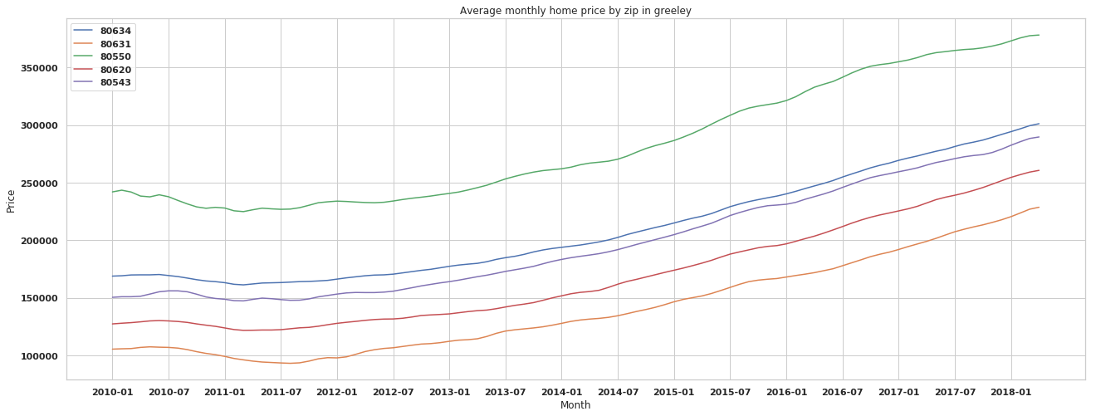
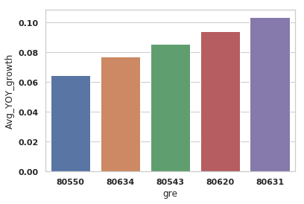
Methods
Began by inspecting the general shape of the data
Calculated the average YOY growth by zip code
Notes:
Began to understand how cities might look slightly different with a general trend of consistent growth. Some were more sluggish to trend upwards out of the market downturn, sagging into 2010-11.
Then calculated which zip codes across the 38 had the highest annual increase in property value averaged across 2010-2018. This was the approach to ensure consistency in performance and remove bias of just the most recent few years.

Slide 6
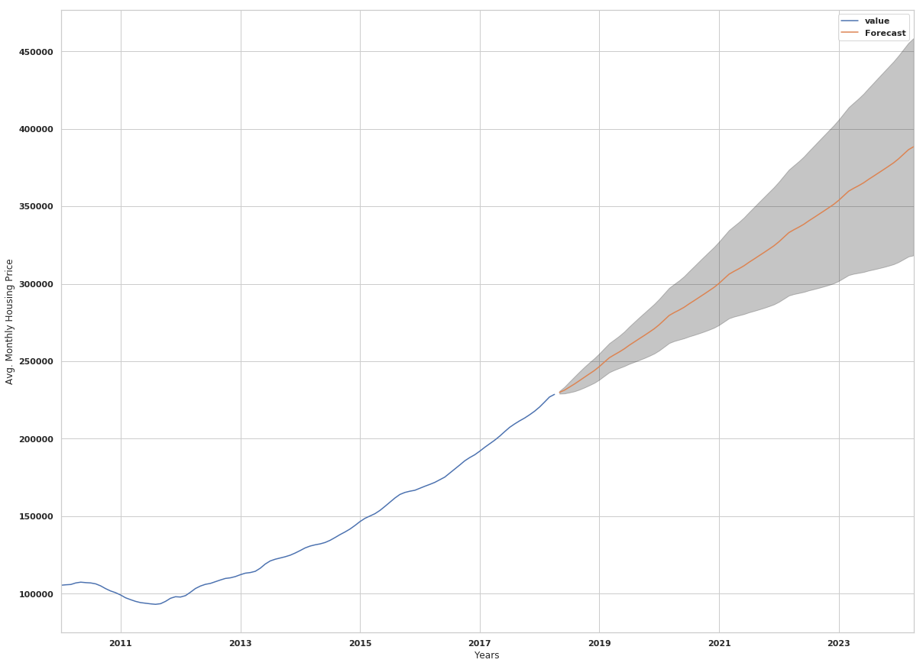
Methods
Use Autoregressive Integrated Moving Average models to predict growth over the next 5 years with confidence intervals
Notes:
I leveraged the capabilities of Python’s statsmodel package to construct SARIMA models for the 10 zip codes that showed the highest average annual increase in average property value over the examined time period. Modeling involved generating stationary data, examining ACF (autocorrelation function) and PACF (partial autocorrelation function) plots to determine seasonal trends and the number of significant lag periods. Multiple parameters were iterated and final parameters were selected based off a balance of minimizing the AIC score of the model and selecting a model with the simplest solution (parsimony principal).
P-values were examined to determine the significance of the feature coefficients. Diagnostics were run to ensure normality of model residuals along a linear trend, the absence of seasonality, and low residual correlation with lagged versions of themselves.
Again, the power of statsmodels was used to forecast future average property values for 72 periods (months) or 5 years with 95% confidence intervals (grey shading).

Slide 7
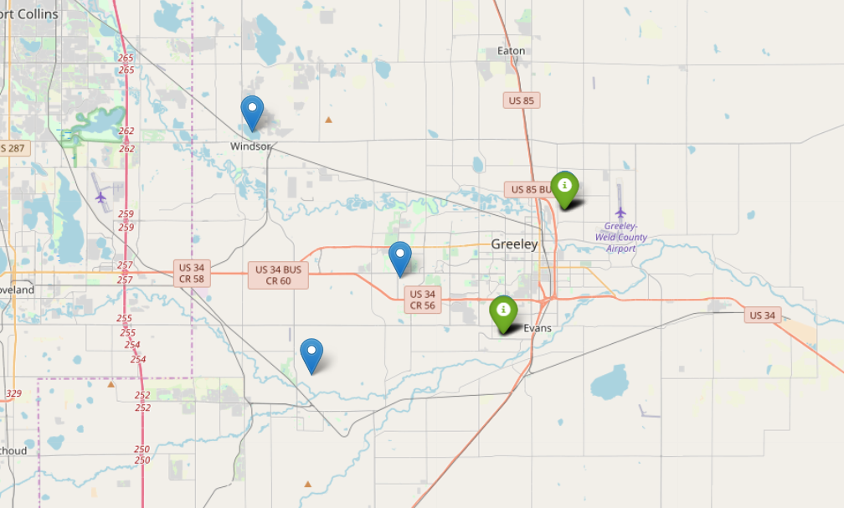
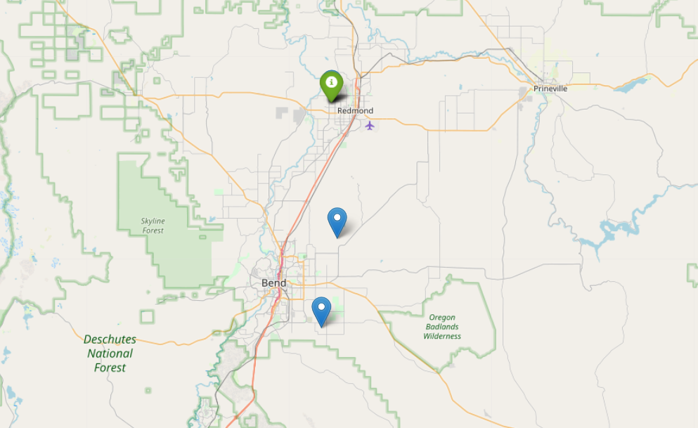
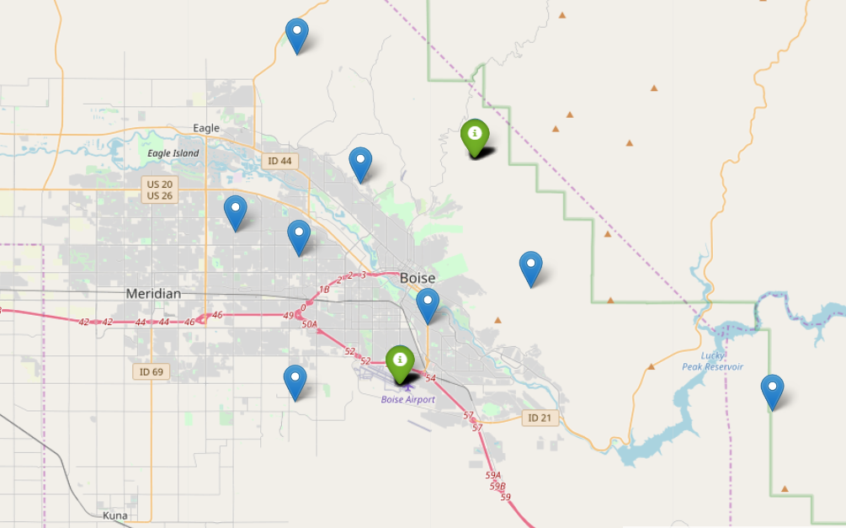
Findings
Of the 10 zips chosen to model, 5 were final selections
Proj. Avg. Annual ROI
12.4-13.1%
Notes:
The five zip codes that showed the highest projected average Annual ROI were in Boise City, Idaho, Greeley Colorado, and in Redmond Oregon.
Projected Annual ROI is the 5-year average annual return on the cash investment of the property again assuming rent revenue is 1% of the home value per month, adjusted for an annual property value increase matching the projected rate of growth predicted by the models, with total annual expenses for the property totaling 2% of the current property value.
The models predict annual ROI earnings between 12.4 and 13.1%, which outperforms the industry benchmark of 6-12%

Slide 8
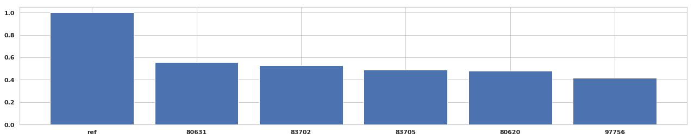
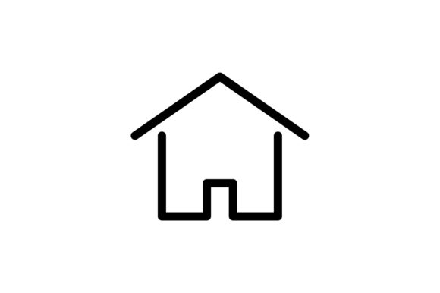
Findings
Zip | City | Projected Property Value Growth (%)
80631 | Greeley | 55.6
83702 | Boise City | 52.7
83705 | Boise City | 49.1
80620 | Greeley | 48.0
97756 | Bend-Redmond | 41.5
Notes:
5 years following the acquisition of the properties there might be interest in selling the properties to invest the capital elsewhere.
The models project the listed return on the sale of a property purchased at the current (April 2018) average property value and sold in April 2023. This does not factor in any costs that would be involved in major home repairs following rental tenants or general wear and tear on a property (new roof, repaved driveway, re-landscaping, etc.)

Slide 9



Recommendations
Purchase properties in Greeley, Boise City, and Bend-Redmond in the areas of town specified
Hold the properties for a minimum of 5 years to maximize ROI
Increase rent annually to match the market
Notes:
Again, modeling and recommendations are being made assuming properties are purchased in cash with no financing.
Increase rent annually to match the market – this could lead to renter turnover, so additional/continued analysis might be necessary to determine market climate

Slide 10
Future work
Additional research on other factors impacting growth of property values
Expand the search
Further exploring the viability of actualizing the projected rates
Notes:
While compiling the visualizations, it appeared areas near airports had higher projected future growth. Is that real or just coincidence?
Additional research on other factors that might impact growth of property values – are there local events that could move the markets one way or the other (new factories, poor schools)
Expand the search to other growing areas, specifically some higher property value areas and/or urban areas
Exploring the viability of actualizing the projected rates. Would love to conduct additional research on other costs of renting in these or other areas such as tax rates, cost of property management, insurance, etc. to produce stronger models

Slide 11
Thank you!

